Slide 1
Eastern Religions / Philosophies

Slide 2
Lecture Notes on Hinduism
Leave a little space for additional details / facts from your text book

Slide 3
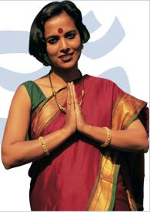
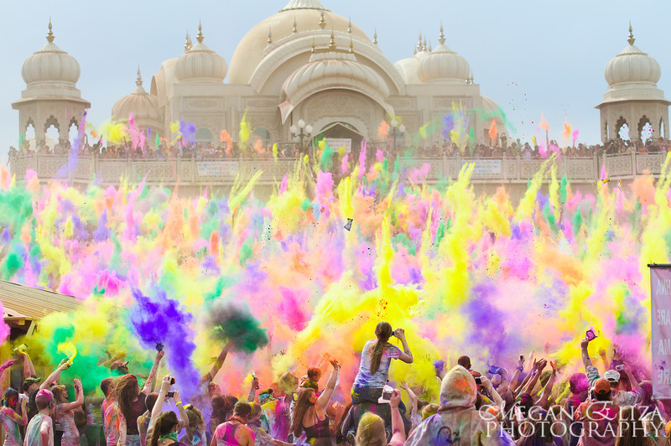
Introduction
Hinduism is the third largest religion in the world, with approximately 900 million adherents
It is also the oldest known religion in the world today
The origins cannot be ascribed to any single founder or a specific time or a single place

Slide 4
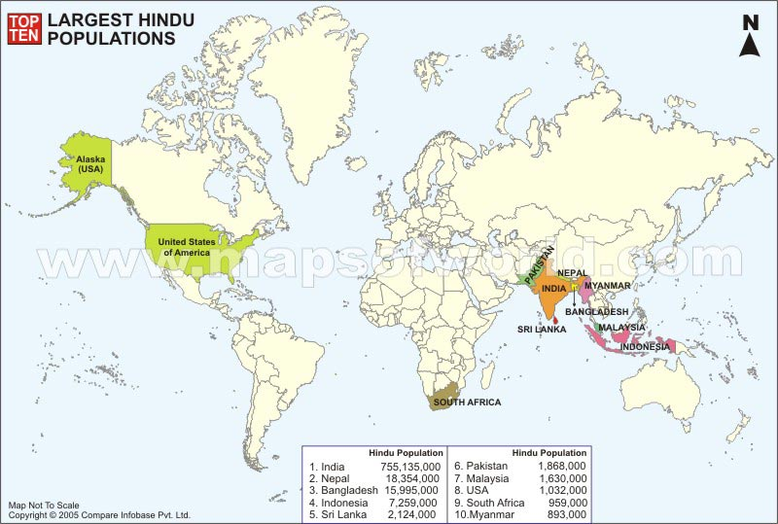

Slide 5
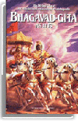
Major texts of Hinduism
The Vedas
The oldest Hindu sacred texts (in 4 parts), composed in Sanskrit
In the oral tradition for hundreds of years
The Bhagavad Gītā (400 BCE)
It is perhaps the most famous, and definitely the most widely-read text of ancient India.

Slide 6
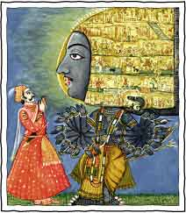
Brahma (the big guy)
There is one big God
More of a all powerful force—no personal characteristics
The Vedas depict Brahma as the Universal Soul

Slide 7
Polytheistic?
Many Hindus believe in many deities
Key: The way these very interesting looking gods are portrayed are not to be taken literally
The Hindu Big Three:
Shiva
Brahma
Vishnu
After this top tier, there is a long list of second-tier deities

Slide 8
Shiva
Shiva is the Destroyer
Even though he represents destruction, Shiva is viewed as a positive force

Slide 9
Shiva

Slide 10
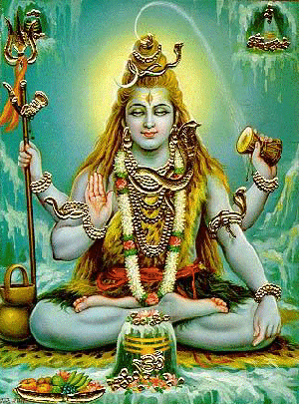
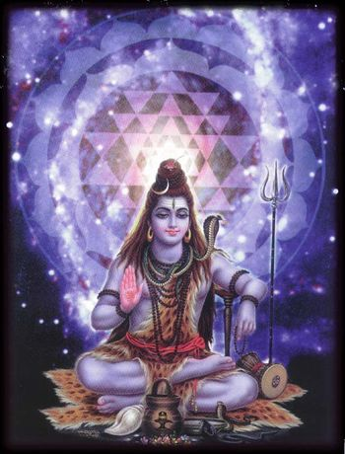
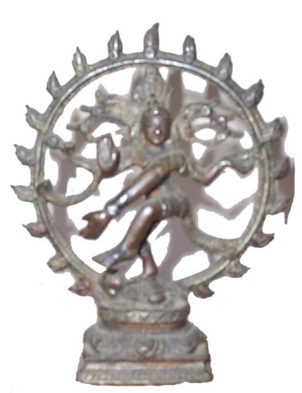

Slide 11
Symbolism of Shiva
Third Eye: Eye of wisdom.
Cobra Necklace: Beyond the powers of death
Matted hair: Lord of wind
Drum: Source of all language and expression.
Tiger skin: The tiger is the vehicle of Shakti, the goddess of power and force.
Elephant & Deer Skin: Elephants represent pride. Deer represent the jumping of minds
Trident: Symbolizes three functions of the triad – the creation, the sustenance and the destruction.
There are many more

Slide 12
Brahma
Brahma is the Hindu God of Creation
Brahma is traditionally depicted with four heads, faces, and arms.
world soul/universal spirit
He is not worshiped (like the other 2)

Slide 13
Brahma

Slide 14
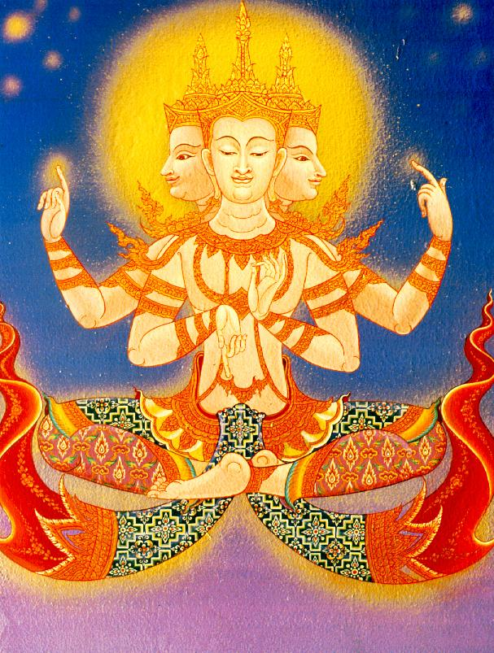
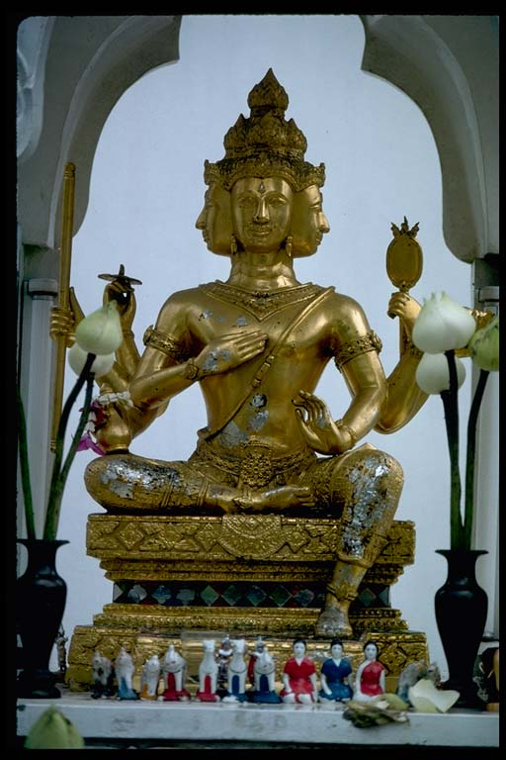

Slide 15
Vishnu
Vishnu is the Preserver, he is most famously identified with his human and animal incarnations (AKA, avatars)
He manifested Himself as a living being in ten avatars.
For Vaishnavas, he is the Ultimate God. The Brahman.

Slide 16
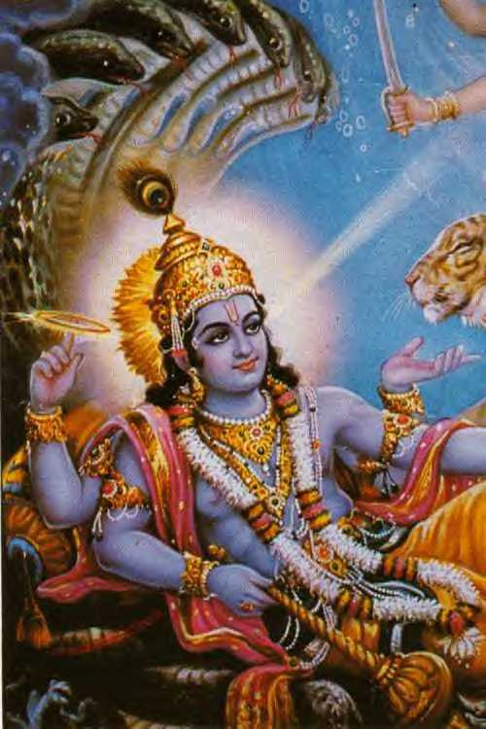

Slide 17
Vishnu
Avatars
(Fish)
(Turtle)
(Pig/Boar)
(Lion man / from the torso upwards lion, below, human)
(First fully human form as a dwarf sage who has the ability to grow very, very tall)
(Fierce man / Hunter)
(Greatest Warrior/ Ideal man)
(Mentally advanced man)
(Sage who is completely still)
(Prophesied, yet to take place)

Slide 18
Kali
Kali - the kick-butt goddess of death and radical transformation

Slide 19
Kali wears a necklace made from men's skulls

Slide 20
March 27, 2018
On your desk
SS notebook – text books
Eastern Religions / Philosophies
Stamp sheet
Foreign Policy Paper
Refinement of notes for Ganesha

Slide 21
Ganesha
Ganesha is one of the most well-known and loved Gods
He is the first born son of Shiva
The Lord of Good Fortune
Provides prosperity and fortune
Also the God of knowledge (Wisdom and Learning – Remover of Obstacles)
Used to help student’s study!

Slide 23
Saraswati
Hindu Goddess of knowledge,
music, art, wisdom and learning worshipped throughout Nepal and India.
She is a part of the trinity (Tridevi) of Saraswati, Lakshmi and Parvati
Quick drawing --

Slide 25
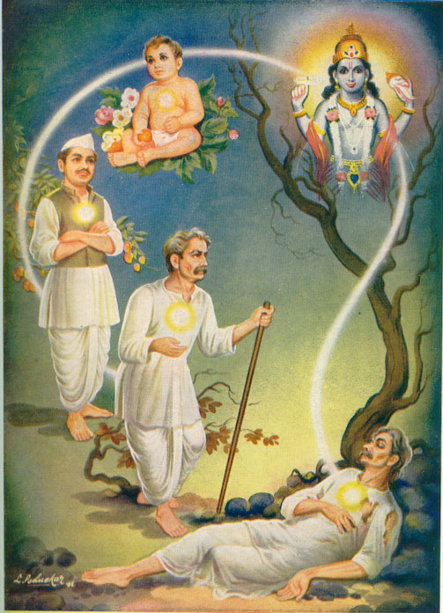
Beliefs of Hinduism
Reincarnation: Samsara: after death, souls are reborn into another form; reincarnation is determined by karma and dharma; central feature of Hinduism
Souls migrate from body to body over many lifetimes, depending on one’s actions

Slide 26
March 26, 2018
On your desk
stamp sheet
outline
SS today – computers – work on final draft of Foreign Policy Paper
LA today – Folklore lesson
Begin film – Big Fish

Slide 27
Atman – individual human soul, part of Brahma
Ultimate goal of humankind is to be one with Brahma, “end our illusory perception of a separate existence”
Moksha – means liberation, the ultimate goal to be one with Brahman and break the cycle of rebirth/reincarnation - Many paths to moksha
Samsara – Sanskrit - “wandering” / “world” - cyclic change – theory of rebirth – cycle of all life, matter, existence
Ahimsa: moral principle of nonviolence to all living things
all people & things are part of the Brahman → deserve respect
a key moral principle of Hinduism

Slide 28
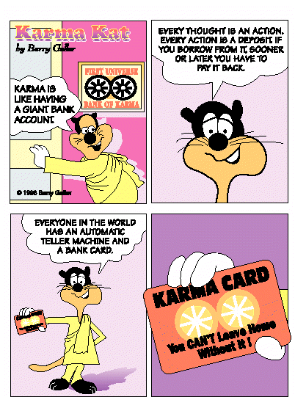
Karma = actions Dharma = duties

Slide 29
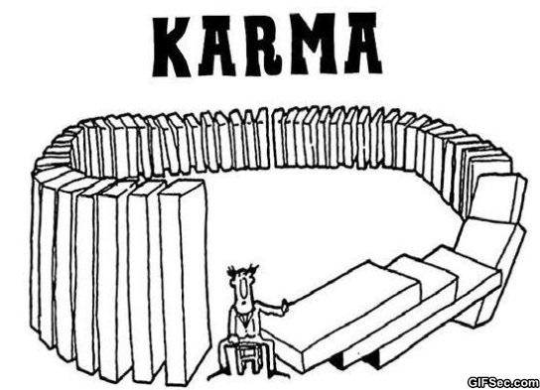
Beliefs of Hinduism
Karma: all the actions of a person's life that affects his or her fate in the next life;
People who earn a good karma are reborn at a higher level of existence
Spiritual principle of cause and effects
The actions of an individual in the present (cause) can influence their future/next life (effect)

Slide 30
Dharma: the religious and moral duties of an individual;
by obeying one's dharma, a person acquires merit for the next life
Dharma –
Ties in to the caste system - concept of social order
Social class assignment from birth
Every class has a duty
More later when we do our India unit

Slide 31
How does the caste system influence Hindu beliefs?
Caste System = social classes into which you are born and cannot change
after death, Hindus hope to be reincarnated into a higher caste
each caste has its own dharma
More later in our India unit

Slide 32
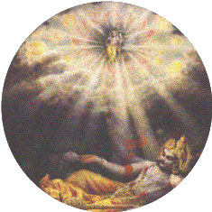
If you obey your dharma and have good karma you will be reincarnated to achieve Moksha.

Slide 33
Discuss in Groups - Create a graphic
Birth
Samsara
Death
Samsara
Death
Moksha
Brahman

Slide 34
samsara

Slide 35
Use your text for Hinduism
You have the page numbers listed
Scan your text
Scan your notes
Add a few more details

Slide 36
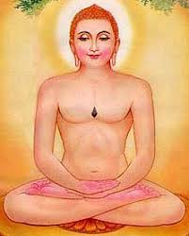
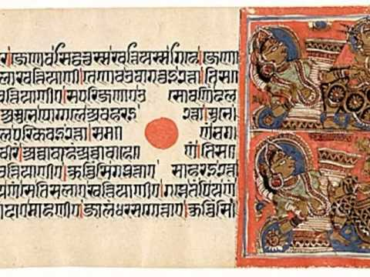
Jainism
Develops from Hinduism
~500 BCE
No single founder
Rejects the authority of the Vedas and Brahmanism
Doesn’t believe that Brahmin priests alone could preform certain sacred rites
Dismisses the caste system
Teaching emphasize meditation, self-denial, nonviolence

Slide 37
Jainism
Doesn’t believe in a God or gods
Believes in divine (perfect) beings who are worthy of devotion
Rejects the idea of a creator God
Universe & everything in it has always existed
Soul of each living being is unique, uncreated, existed since the beginning of time

Slide 38
Jainism
Tirthankara – “ford-maker”
spiritual teacher - person who are able to cross the sea of endless births and deaths
Mahavira most notable tirthankara
wrongfully called, “founder of Jainism”
Teachings gave Jainism it’s present day form
Prince, from the warrior caste → left that life to fast & meditate → attains liberation (moksha)

Slide 39
Jainism – concepts
Brahman – doesn’t really have this concept because the Universe is eternal
Atman – “jiva” – the human soul
conscious, living being, existed forever
Independent of other souls
Trapped in endless cycle of samsara
Moksha – means liberation, the ultimate goal to break the cycle of samsara
One path to moksha → living life rightfully by following the Three Jewels of Jainism
Notes:
Moksha compared to a bubble in a glass of water breaking though the surface & becoming one with the surrounding atmosphere

Slide 40
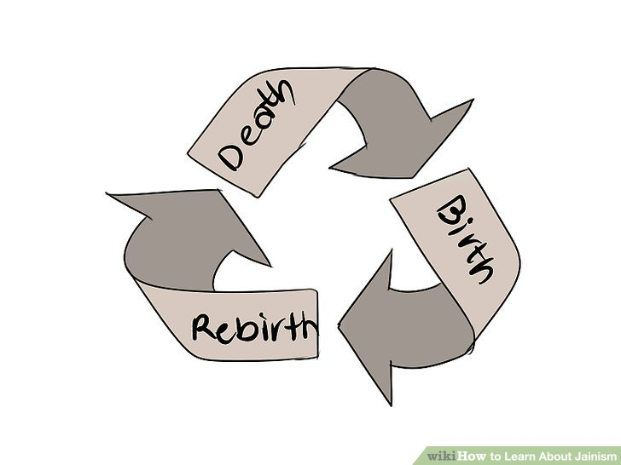
Jainism – concepts
Samsara – rebirth/reincarnation
Human existence is mundane and full of misery
Goal is to liberated of never ending cycle of samsara to moksha
Karma – physical substance that exist everywhere in the universe
Karma particles are attracted to the soul because of the actions of the soul
Karma is the pollution that taints the soul

Slide 41
Jainism – concepts
Ahimsa – the principle of non-violence to all living things
a key moral principle of Hinduism
all people & things are part of the Brahman → deserve respect

Slide 42
Consult your text book . . . Jainism

Slide 43
Buddhism – Background Information
Buddhism started in India by the “Buddha,” or Siddhartha Gautama
Founder: Siddhartha Gautama = an Indian prince who sought to eliminate suffering and devoted his life to achieving nirvana;

Slide 44
Beliefs of Buddhism
Karma
Reincarnation
Buddhists believe in NO GODS;
the Buddha was not normally viewed as a god;

Slide 45
Main Beliefs of Buddhism
Eightfold Path / Middle Way
“the right way;” making the right decisions, actions, effort, etc.

Slide 46
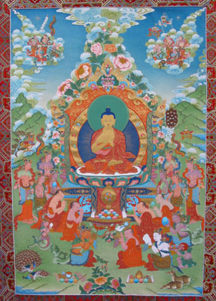
Main Beliefs of Buddhism
Four Noble Truths =
Life is full of suffering
Suffering is caused by desire
Eliminate suffering by eliminating desire
Eliminate desire by following the Eightfold Path / Middle Way

Slide 47
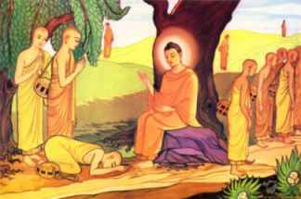
Main Beliefs of Buddhism
Buddhists do not believe in the caste system; Buddhists believe that anyone, at any time, can achieve nirvana;
Nirvana = the goal of every Buddhist; spiritual enlightenment;
Ahimsa = NON-VIOLENCE

Slide 48
John Green ….

Slide 49
March 29, 2018 Read pages 79-82
Take notes / add notes

Slide 50
Add to SS stamp sheet
Due 3/30 – notes for pg 79-82

Slide 51
April 2, 2018
LA –
Big Fish handouts
film
SS
Ancient Religions

Slide 52
April 3, 2018
LA –
Lab 3rd – BMU
No phones in the lab
SS
China - dynasties

Slide 53
April 4, 2018
LA –
Lab 3rd - BMU
SS
China - dynasties

Slide 54
April 5, 2018
LA –
Lab 3rd - BMU
SS
China –silk road . . .

Slide 55
April 6, 2018
LA –
Stamp sheets
BMU hard copy – collect
complete Big Fish
SS
China

Slide 56
March 29, 2018
Known as three jewels
1. Buddha: the person/thought/ideal, etc.
2. Dharma: the teachings of the Buddha
3. Sangha: the community of monks and nuns
Medical metaphor: Buddha is doctor; dharma is medicine; sangha is hospital

Slide 57
A few more concepts . . .
Rebirth occurs through a cycle of life and death or samsara
Goal is to get out (like moksha) and achieve nirvana
While in this cycle next rebirth is dependent on current life and karma
Greater karma = born closer to achieving nirvana
Can be born as human or animal in this world as well as god, demon, hungry ghost, etc. in other worlds
Best chances to do good and build up karma are as a human

Slide 58
Variations of Buddhism
Theravada: basic teachings just given. Found mainly in India and Southeast Asia (Thailand, Laos, Cambodia, etc.)
Mahayana: adds the ideas of bodhisattva and zen as well as more ritual and almost polytheistic devotion; found in East Asia (Japan, China, Korea, etc.)
Vajrayana: add mysticism and polytheism as well as the idea of lamas—Dalai Lama is leader and incarnation of Buddha, compassion. Found only on the Tibetan plateau

Slide 59
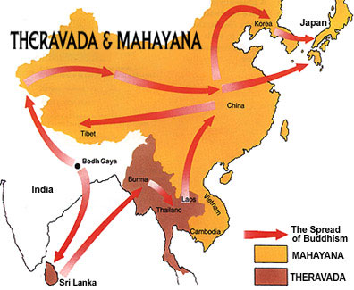

Slide 60
Daoism

Slide 61
One of two indigenous Chinese religions
Dates back to Ancient China (at least 1751 BCE) – some parts very similar to ancient Western religion
Only found in China (and Taiwan)
Centers around the Dao, or way

Slide 62
Promotes unity, virtue, balance, etc.
Main “scripture” is the Tao Te Ching written by Lao Tzu; Chuang Tzu also important
Li or ritual is heavily used; ancestor worship, oracles, spirit mediums also used
Polytheistic kind of, though God(s) are way less important than ancestors/cultural & historical leaders

Slide 63
The Dao
Means “the way”
Involves essentially going with the flow → i.e. don’t worry about the things you can’t change
Calls for human-spiritual-natural unity and peace
Involves constant balancing act of opposites (think Newton’s law of motion)
Stresses moderation
Almost thought of as a deity—when you die your body and spirit go into ultimate unity with the Dao: neither good nor bad, alive nor dead, etc.

Slide 64
Yin and Yang
Yin and Yang:
Represented in the Symbol of the Great Ultimate
In a sense they are opposites yet together, like the Dao
At the same time they keep the balance
Demonstrate the need for some sort of order that goes with the flow → essence of Daoism
All opposites represented within them:
Yin: black, female, dark, winter, cold, death, hate, etc.
Yang: white, male, light, summer, warm, life, love, etc.

Slide 65
Draw it

Slide 67
Chi
self generating energy
Flows throughout body
Some daoists learn to control theirs and use it to their advantage = Tai Chi

Slide 68
Tao Te Ching
Written by Lao Tzu
Series of short poems about life, philosophy, people, etc.
Divided into 2 parts: Tao (the way) and Te (virtue)
relaxed mood and tone; language is simple
Goal is to promote inner peace

Slide 69
Lao Tzu & Chuang Tzu
Lao Tzu
Accredited author of the Tao Te Ching
Name means “old master”
Real? → no historical records / evidence of him
much was oral tradition, so he’s like the Chinese Homer (“author” of Iliad and Odyssey)
Chuang Tzu
Other important Daoist philosopher
real, lived 369-289 BCE
Wrote in parables, short stories, anecdotes, etc.
Blends Daoism with Confucianism

Slide 70
Divinity: Ancestors and Gods
Known as “Folk Daoism”
Based mainly on oral and local traditions
Daoism also has aspects of archaic Western polytheistic religions;
Gods live on mountain, have variety of roles, special powers, stories, etc.
Today gods and spiritual beings still speak through shamans

Slide 71
Also involves praying to ancestors or great people from your region of China
This includes priests, oracles, shaman and sacrifices, and, of course $$ (both on earth and in heaven)

Slide 72
Daoism and Chinese history/culture
Folk Daoism blends traditional religion with the idea of yin and yang and the dao
Indigenous in some areas—it blended with the culture and varied from region to region - sycretism
Also a very personal thing → the one Chinese religion never persecuted before the Communist Revolution in 1940’s

Slide 73
Constant in Chinese culture for 2500+ years
Persecuted and suppressed under Communists and Mao—esp. in Cultural Revolution

Slide 74
Daoism in modernity
Tradition kept alive in Taiwan for 50 years
China began to allow more religion with economic freedom of 1990s
Now it is allowed and even endorsed, temples are opening up, it is thriving
Many aspects of folk Daoism still exist
Exported to west mostly in form of feng shui and tai chi

Slide 75
March 30, 2018

Slide 76
March 30, 2018
SS
Stamp Sheet
Pg 79-82 notes
SS Notebook
text
LA – Stamp sheet
Printed copy first draft
Clean edit page
Rubric (add points)
Big Fish handouts
Peer edit – 30 minutes
Big Fish - 20 minutes

Slide 77
Confucianism

Slide 78
Background
One of two key religions indigenous to China
spread to parts of SE Asia
Generally seen as a reaction to Daoism
More concrete than Daoism
Founded by K’ung Fu Tsu (Confucius) around 6th century BCE; added to by Mencius

Slide 79
Background
Main text is the Analects
2000+ year old running debate on whether it is a religious, philosophy or way of life
popular in mainland modern China→ works well with Communism
Many Chinese combine it with Daoism and folk religion to create hybrid

Slide 80
Confucius
Confucius (K’ung Fu Tsu, Kong Fuzi)
Born in Shantung in 551 BCE to poor/ish family; self-educated and well read
Married a woman of higher status
became a local administrator
In 50’s got frustrated with corruption, turned to teaching and philosophy
Ideas started to catch on, got caught in the middle of a civil war

Slide 81
Mencius
Mencius (M’eng Tsu, Mengzi)
Lived 300’s BCE
also began life as an administrator
Reintroduced Confucianism after civil war
Came up with strong ideas of family devotion
(filial piety)
Long, explanatory writings compared to snippets of Confucius

Slide 82
Beliefs
General idea is to become a Junzi, or “Superior Man”
People are considered basically good and need to learn to harness that good
Done through self control, hard work, devotion
Mixes in elements of hierarchy→ knowing ones role and doing
Order and Ancestor Worship
Family becomes important and relationships within that family
Five key relationships: parent-child; husband-wife; older siblings-younger siblings; friend-friend; ruler-subject

Slide 83
Beliefs
Leads to Silver Rule:
Do not do unto other as you would not have them do to you; essentially do no harm
Doing all this on small level = a good, large level
Much like Daoism, believes in parallel heaven but does not specifically focus on a god or gods.

Slide 84
April 2, 2018 – 3 -4
On your desk
LA 3rd
Big Fish film guides
SS – 4th
SS notebooks
text books

Slide 85
Writings
Analects
Record of Confucius’ teachings written down by his students
Short maxims (basis for “Confucius say ______.”)
Young man should respect father at home, boss at work, elders abroad; cultivate friendships with all
People can be led by fear but it would be better for them to be led by virtue

Slide 86
Real knowledge is to know the extent of one's ignorance
By three methods we may learn wisdom: First, by reflection, which is noblest; Second, by imitation, which is easiest; and third by experience, which is the bitterest
When anger rises, think of the consequences
It is easy to hate and it is difficult to love. This is how the whole scheme of things works. All good things are difficult to achieve; and bad things are very easy to get.
To know what you know and what you do not know, that is true knowledge.
Study the past, if you would divine the future.

Slide 87
Writings
Five classics
Spread through Asia and became basis for eastern philosophy
Contains works of Confucius and others
Most famous is the I Ching which codifies the idea of the universe and your role in it.

Slide 88
Development in history
More acerbic (sharp – forthright – sarcastic)than Daoism = more controversial
With Confucius’ death and civil war, his student spread out- differing ideas - created scholarly community of the Hundred Schools of Thought
Literati—intellectual elite—gain power

Slide 89
Development in history
Eventually seen as a problem by the government -led to era of Book Burning / attacks on scholars
swings back and became basis for hierarchy of Chinese government and official religion of the state
Added to folk Daoism & Buddhism to create state religion of most Chinese until Communism (1940’s)

Slide 90
After era of book burning, Confucianism was existed peacefully - allowed by the state for nearly 2000 years
Like Daoism, came under fire during Cultural Revolution (Mao) as naïve, old world philosophy
Violently persecuted in 1960s and 1970s

Slide 91
Confucianism
Now seen as “jewel” of ancient state
Also influential in other Asian countries, most notably Korea and Japan

Slide 92
Use your text
See list of page numbers for Confucianism
Scan and take notes that are not in your lecture notes

Slide 93
April 3, 2018
LA – 3rd
Lab – work on BMU
SS – 4th
Add to stamp sheets
4/4 - 2 quilt pieces - 4/5 - 2 quilt pieces
4/6- 2 quilt pieces - 4/6-quilt pieces cut out
John Green - China
Work on Quilt assignments

Slide 94
April 3, 2018
Add to stamp sheets
4/4 - 2 quilt pieces - 4/5 - 2 quilt pieces
4/6- 2 quilt pieces - 4/6-quilt pieces cut out
John Green - China
Work on Quilt assignments

Slide 95
Quilt Assignments
Culminating Grades =
INDEPENDENT WORK =
No talking during class time given to work on your quilt pieces
Talking during work time = point deductions for quilt grade
Your colored paper is for final draft quality work!!
First draft / Final draft is the way to go

Slide 96
Questions – SHORT ANSWER
SHOULD REQUIRE ONE TO TWO SENTENCES TO ANSWER
QUESTIONS ON THE FRONT
ANSWERS ON THE BACK

Slide 97
April 4, 2018
LA – 3rd
Lab – work on BMU / peer edits if you have arranged to do so with a partner
Extra peer edit sheets available
Friday – paper clipped together!!!
Top to Bottom
BMU paper, first draft, peer edit sheet, stamp sheet

Slide 98
April 4, 2018 – New Rubric – Also Online
SS – 4th
Quilt Work is independent work for the Culminating category – like a test
^{No talking -}
Lab as needed for quilt assignment
Add to stamp sheets
4/4 - 2 quilt pieces 4/5 - 2 quilt pieces
4/6- 2 quilt pieces 4/6-quilt pieces cut out

Slide 100
BUDDHISM
1. Draw a scene from the Buddha’s life or Buddhism
Write and answer 5+ quiz questions
Answers on back
3. Write a rap (or country song) about the Buddha’s life of Buddhism
4. Create a propaganda poster for the Buddha
HINDUISM
1. Draw a scene from a Hindu text
Write and answer 5+ quiz questions
Answers on back
3. Write a rap (or country song) about Hinduism or a teaching within Hinduism
4. Create a propaganda poster for one of the avatars of Hinduism or Brahman
CONFUCIANISM
Draw a scene from the Confucius’s life or Confucianism
Write and answer 5+ quiz questions
Answers on back
3. Write a rap (or country song) about Confucius’s life or Confucianism
4. Create a propaganda poster for the Confucianism

Slide 101
April 5, 2018
LA – 3rd
Lab – work on BMU / peer edits if you have arranged to do so with a partner
Extra peer edit sheets available
Tomorrow – paper clipped together!!!
Top to Bottom
BMU paper, first draft, peer edit sheet, stamp sheet
SS – 4th
^{No talking – independent work}
4/4 - 2 quilt pieces 4/5 - 2 quilt pieces
4/6- 2 quilt pieces 4/6-quilt pieces cut out

Slide 103
BUDDHISM
1. Draw a scene from the Buddha’s life or Buddhism
Write and answer 5+ quiz questions
Answers on back
3. Write a rap (or country song) about the Buddha’s life of Buddhism
4. Create a propaganda poster for the Buddha
HINDUISM
1. Draw a scene from a Hindu text
Write and answer 5+ quiz questions
Answers on back
3. Write a rap (or country song) about Hinduism or a teaching within Hinduism
4. Create a propaganda poster for one of the avatars of Hinduism or Brahman
CONFUCIANISM
Draw a scene from the Confucius’s life or Confucianism
Write and answer 5+ quiz questions
Answers on back
3. Write a rap (or country song) about Confucius’s life or Confucianism
4. Create a propaganda poster for the Confucianism

Slide 104
April 6, 2018
SS – 4th
Names on back of all your quilt work- PRINT NEATLY
Will your name be visible after it is taped on the quilt?

Slide 105
April 6, 2018
SS – 4th
Group Work
Figure out how large the background of your quilt should be
You will need to tape two pieces together
Do you want enough room around each square to see background?
OR NOT?
Tape the seams on both sides

Slide 106
April 6, 2018
SS – 4th
Group Work
Figure out how large the background of your quilt should be
You will need to tape two pieces together
VERY LITTLE OVERLAP FOR THE TWO PIECES
Tape the seams on both sides
PAPER IS DELICATE - BE CAREFUL!!

Slide 107
Group Work
Quilt pieces arranged in an appealing manner
Create a pattern (colors, numbers, religions)
The most organized, efficient groups in
5th period created a “key”
before starting to tape pieces on
Tape only the top of each quilt piece so it can be lifted to see the opposite side

Slide 108
April 6, 2018
You need one post it per quilt – put your name on each post it
Heading on a loose piece of paper – Copy and answer one set of questions per quilt
quilt 1 – BQ or HQ or CQ
quilt 2
etc….
Write your name on all you post-it notes – SMALL AND PRINTED
When you visit your own quilt leave a complement for someone in your group

Slide 109
April 6, 2018
You need one post it per quilt
5th period – 5 post-it notes
Heading on a loose piece of paper - Answer one set of questions per quilt
quilt 1
quilt 2
etc….
Write your name on all you post-it notes – SMALL AND PRINTED
When you visit your own quilt leave a complement for someone in your group

Slide 110
#7 – John Green – 2000 years of Chinese History! The Mandate of Heaven and Confucius

Slide 111
What is a quilt?

Slide 112
BUDDHISM
1. Draw a scene from the Buddha’s life or Buddhism
2. Write and answer 5+ quiz questions
3. Write a rap (or country song) about the Buddha’s life of Buddhism
4. Create a propaganda poster for the Buddha
HINDUISM
1. Draw a scene from a Hindu text
2. Write and answer 5+ quiz questions
3. Write a rap (or country song) about Hinduism or a teaching within Hinduism
4. Create a propaganda poster for one of the avatars of Hinduism or Brahman
CONFUCIANISM
Draw a scene from the Confucius’s life or Confucianism
2. Write and answer 5+ quiz questions
3. Write a rap (or country song) about Confucius’s life or Confucianism
4. Create a propaganda poster for the Confucianism

Slide 113
April 16, 2018
Distribute spring project
Discuss directions and due dates
Step 1 due 4/17
Step 2 due 4/17

Slide 114
April 17, 2018
Check in step 1 and 2 homework
Library time to begin project
Topic due 4/18

Slide 115
April 18, 2018
On your desk
text book
SS notebooks
homework

Slide 116
April 18, 2018
How to do a source analysis
Please take notes
msbacon.com

Slide 117
It is time for a singing competition . . .

Slide 118
Timeline of Chinese Dynasties:
Song Dynasty
16 Kingdoms
Han Dynasty
Northern Song
Southern Song
Eastern Zhou Dynasty
Xin
Five Dynasties & Ten Kingdoms
Three Kingdoms Period
Jin
Xia Dynasty
Western Han
Yuan Dynasty
Western Zhou
Shang Dynasty
Qin Dynasty
Eastern Han
Ming Dynasty
Qing Dynasty
Eastern Jin
Spring & Autumn Period
Warring States Period
Western Jin
Sui Dynasty
Western Xia
Wu
Southern & Northern Dynasties
Tang Dynasty
Liao
2000 CE
1500 1000 700 600 500 400 300 200 100 0 100 200 300 400 500 600 700 800 900 1000 1100 1200 1300 1400 1500 1600 1700 1800 1900
2000 BCE
Ancient China
Imperial China
Modern
China

Slide 119
Time Travel Tourism
You will be assigned to a group
You will read about one time period of Chinese history
You will be a travel agent for this time period.
You will create a travel poster
You will do a group presentation promoting travel to your assigned TIME
Classmates will take notes on your presentation

Slide 120
Note taking guide
Dynasty Name and Time Period
People and Events
Cultural Universals – Components of Culture
Geography
Summary – Present Day Connections
READY ? – WRITE THE NAME OF YOUR DYNASTY

Slide 121
Dynasty is based on the group # you were given
Shang
Zhou
Qin(Ch’in)
Han
Sui
Tang
Song
Yuan
Ming
Ching
Republic

Slide 122
Sources
Text book
Handouts
If your name has the dot . . .
pick up the handout for yourself
and the others
who have been assigned to the same time period

Slide 123
Class time tomorrow for Time Travel Tourism
That was the end of group work for today
On your own, Begin taking notes . . .
Friday – Research Day for spring research paper
Monday – Topic Adjustment and Research Question due

Slide 124
April 19, 2018
Research Question lesson
Work on time travel tourism
Poster requirements

Slide 125
April 19, 2018
On your desk
project directions
notes & handouts for Time Travel Tourism
text books

Slide 126
Research Question due 4/23
Research Question Examples:
How did _________ impact __________ and what role did the U.S. play in this conflict?
What role did __________ play in __________and what role did the U.S. play in this conflict?
What role did economics play in the 1st Crusade?
What role did economics/politics play in the Mughal Conquest of India?
What role did religion play in the European conquest of the Americas?
How did religion impact the colonization of Africa?
How did technology impact the Mongol Conquests?
How did the First Indochina War impact the environment?
What role did political systems play in conflicts in Myanmar?
What role did ethnic group identity play in violence in the DRC?
How did military alliances impact the Israel-Egypt conflict?

Slide 127
Regarding step 3
I will not ask you to show me 5 facts regarding the involvement of international organizations.
You should be looking for this information for your notecards.
It reinforces the idea that the topic you’re researching is a global issue, hence global interest and involvement.

Slide 128
To begin today . . .
Read: Zhou Dynasty Further Defines China
Receiving the Mandate of Heaven – page 94-95
Review the Dynastic Cycle illustration on page 95
Read all the text in the illustration
Replicate the diagram in your notes

Slide 129
Note taking guide for your assigned time period Organize notes into these categories
Dynasty Name and Time Period
People and Events
Cultural Universals – Components of Culture
Geography
Summary – Present Day Connections

Slide 130
April 20, 2018
3-4 Carts
5 lab

Slide 131
April 23 - Shakespeare
Check in topic adjustment and research question
¾ - work on time travel tourism
5 - library

Slide 132
April 24 – Shakespeare – Periods 3-4
Work on Posters
Work on individual verbal presentation
at least 4 MOST IMPORTANT facts
you may have notecards, but memorizing as much as possible is best
Group work on time travel presentation
library on Thursday and Friday for spring paper
Presentations will begin on Monday 4/30

Slide 133
April 24 – Shakespeare – Period 5 – lab 4/26, library 4/27
Complete notetaking
Groups assign who will do what part for their poster / presentation
select colors
Work on Posters
Work on individual verbal presentation
at least 4 MOST IMPORTANT facts
you may have notecards, but memorizing as much as possible is best
Group work on time travel presentation
Presentations will begin on 4/30

Slide 134
Group Work – divide the categories among your group Your poster should focus on your assigned category/s Record who is doing what - then turn in the list
20 Points
Accurate information focused on your assigned portion of the Time Period
Appealing travel advertisement for your place and time
* an overarching slogan – related to your assigned category/s
* visual/s
* propaganda techniques
10 points – verbal presentation – travel advertisement (commercial)
voice projection, voice clarity, voice inflection, eye contact,
considerate of the audience (who are taking notes) propaganda techniques used
Extra credit ??? Dynasty Song ?????

Slide 135
April 25, 2018- Shakespeare
Time travel group work , practice
Begin presentations – 6 – 40 -45 minutes
4/26 – library 3-4 lab – 5
Source analysis due if needed
4/27 – notecards due 10 pm and library day for ¾ and 5

Slide 136
4/26
4/26 – library 3-4 lab – 5
Source analysis due if needed

Slide 137
4/27 – notecards due 10 pm and library day for ¾ and 5
First thesis due Monday 4/30

Slide 138
First thesis due Monday 4/30
Outline reminders
Time travel tourism presentations – 6 40-45 minutes
5/1 – lab
5/2 lab

Slide 139
5/1 – lab
5/2 lab
Outline due 5/3 in class
Outline due by 10 pm

Slide 140
5/1 – lab
5/2 lab
Outline due 5/3 in class
Outline due by 10 pm

Slide 141
5/3 – peer edit outlines
Outline due 10 pm
Presentations – 4 – 30 minutes

Slide 142
5/4 –
First draft due turnitin.com on 5/7 – lab day
First draft due in class 5/8

Slide 143
5/7 – lab day
First draft due turnitin.com on 5/7
First draft due in class 5/8

Slide 144
5/8
Peer edit first draft in class

Slide 145
5/9
Lab 3/4 and 5
2nd draft 5/10 in class and 10 pm

Slide 146
5/10
2nd draft due in class – peer edit
Lab on 5/11
Paper due 5/13 – 10 pm
Pager due in class 5/14 -

