Slide 1
June 8 – PPYP – Test Monday
2nd semester
Review Work on Tues. and Weds.
Great Depression / New Deal
WWII – American Neutrality, key players
1945-1960 ( 1950’s unit)
1960’s / Vietnam
Nixon/Watergate/Ford/Carter/Reagan

Slide 2
End of 1971 troops - 50,000 US deaths – 2,357 Define Pentagon Papers Who leaked excerpts to the press?

Slide 3
The Pentagon Papers revealed many things including . . .
U.S. activity included airstrikes against Laos, coastal raids of N.V. and U.S Marine Corps attacks — before President Johnson informed the American public, while at the same time promising to not expand the war. A draft of the “Gulf of Tonkin Resolution” was written before the Gulf of Tonkin incident

Slide 4
Pentagon Papers widened the credibility gap between the U.S. government and its people
Hurt Nixon’s war effort
In addition to the federal court injunction, led to
New York Times v. United States . . .
Nixon had members of his inner circle G. Gordon Liddy and E. Howard Hunt (members of the White House Special Investigation Unit – nickname - the "White House Plumbers" broke into the office of Ellsberg's psychiatrist hoping to get information to discredit Ellsberg

Slide 5
Feb. 1972 – Nixon visits China – historic visit
–“Détente” – Henry Kissinger
National Security Advisor & Sec. of State
May 1972- increased bombing in N. Vietnam &
mines in N. Vietnamese harbors
May 1972 – Nixon visits Soviet Union
– SALT 1 - “Détente”
June 17, 1972 - Break in at the Watergate
Hotel in Washington D.C.
– 5 men arrested
– brought to you by CREEP
– Committee to ReElect the President

Slide 6
Watergate Burglars

Slide 7
Oct. 1972 - 1972 Pres. Campaign
– Nixon seeking reelection
– George McGovern
Democratic Candidate
Nixon’s reelection campaign
“Peace is at hand”
“Peace with honor”
Détente with USSR & China

Slide 8
Peace with Honor =
S. Vietnam independence recognized by NV
Exchange of POW’s
S. Vietnamese leader (Pres. Thieu) objects
to proposed settlement
(no provision for the withdraw of
Viet Cong groups from South Vietnam)
Your thoughts ???

Slide 9
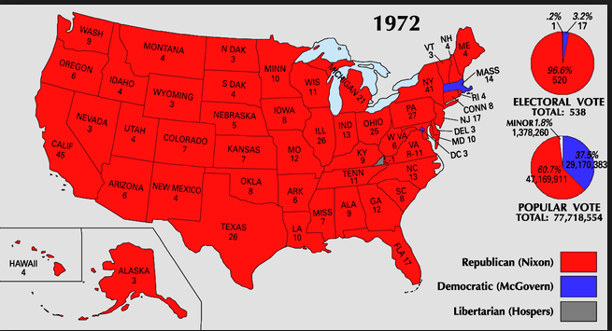
Nov. 1972 -
Nixon re-elected in landslide victory

Slide 10
Nixon 520 Electoral Votes out of a total of 538 Bigger Landslide than Johnson in 1964 As you know, Nixon will not complete his second term as POTUS

Slide 11
Negotiations to end the war in
Vietnam became deadlocked
again in November and
December of 1972
What did Nixon do???
He promised “Peace is at Hand”

Slide 12
December 18 – 29, 1972
“Christmas Bombing”
“December Raids”
– 12 days of bombing
Nixon - “bombing them back to
the table”

Slide 13
Dec. 18-29 – 1972
“Christmas Bombing”
“December Raids”
bombing of N. Vietnam escalates
to force N. Vietnamese to
negotiate – 12 days of bombing
Nixon - “bombing them back to the table”
– 15 American B-52 bombers lost –43 killed in action - 49 taken prisoner
1972 – 20,000 - US deaths – 640

Slide 14
Christmas Bombing
December Bombing
1972
15 American B-52 bombers lost
43 killed in action
49 taken as POW’s
1972 – 20,000 - US deaths – 640

Slide 15
1973 – January 27 – Peace Treaty
*CEASE FIRE, NO WITHDRAW OF VIETCONG
*WITHIN 60 DAYS ALL US TROOPS, MILITARY ADVISERS AND MILITRY PERSONNEL LEAVE S. VIETNAM & ALL US BASES DISMANTELED
*US WILL NOT CONTINUE MILITARY INVOLVEMENT OR INTERVENE IN AFFAIRS OF S. VIETNAM

Slide 16
1973 – January 27 – Peace Treaty
*ALL POW’S RETURNED TO THEIR HOME NATIONS
*SELF-DETERMINATION FOR THE S.VIETNAMESE
*REUNIFICATION OF N. AND S. VIETNAM TO BE CARRIED OUT IN A STEP BY STEP PEACEFUL PROCESS
*NEGOTIATIONS BETWEEN THE N. AND S. VIETNAMESE GOVT. – NO FOREIGN INTERFERENCE
*TIMETABLE DETERMINED BY N. AND S. VIETNAM

Slide 17
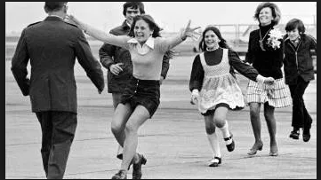
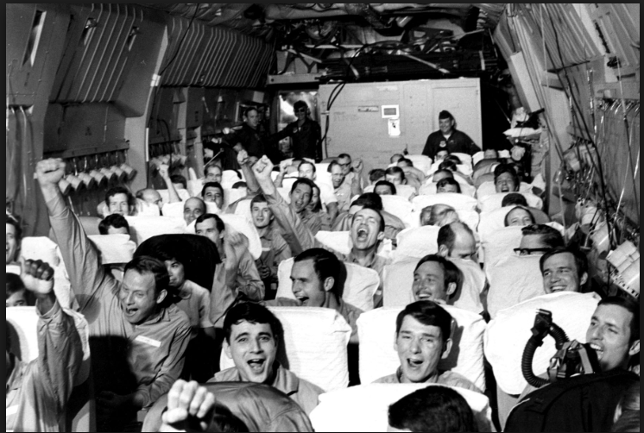
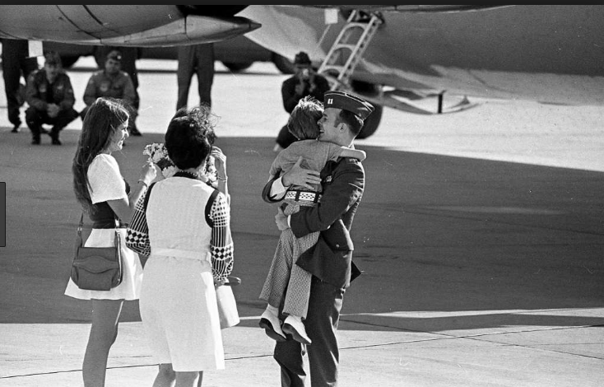
April 1973 – 591 American POW’s released
“Operation Homecoming” At that time however,
1350 Americans as POW or MIA

Slide 18
Apx. 1200 reported as KIA, but bodies not recovered
Total Americans missing at the end of the war
2,646 (KIA, LKA, POW, MIA)
1973 - US deaths – 168
Totals
US deaths – nearly 58,000
US wounded - 300,000
$150 billion

Slide 19
Totals for Vietnam
South
army 220,000,
civilians 300,000 to 1 million
Half the population Refugees
1,000,000 wounded
North
??? estimates
military 600,000 - 1,000,000
civilians 65,000 – 1 million

Slide 20
1974
Remains of 23 Am. Soldiers come home
Am. Families form organizations to insist that the US Gov. continue efforts to search for MIA’s and possible POW’s
AUGUST 1974 – NIXON RESIGNS
AFTER THE RELEASE OF THE LAST AMERICAN POW’S, FIGHTING GRADUALLY INCREASED BETWEEN THE SOUTH VIETNAMESE AND THE VIETCONG

Slide 24
1974
Remains of 23 Am. Soldiers come home
Am. Families form organizations to insist that the US Gov. continue efforts to search for MIA’s and possible POW’s
AUGUST 1974 – NIXON RESIGNS
AFTER THE RELEASE OF THE LAST AMERICAN POW’S, FIGHTING GRADUALLY INCREASED BETWEEN THE SOUTH VIETNAMESE AND THE VIETCONG

Slide 25
FEBRUARY 1975
NORTH VIETNAMESE TROOPS INVADED
SOUTH VIETNAM
3 MONTHS LATER
THE NORTH HAD THE SOUTH’S CAPITAL
OF SAIGON SURROUNDED
S.Vietnamese PRES. THIEU ASKED THE
U.S. GOV. FOR ASSISTANCE
PRES. GERALD FORD ASKED CONGRESS FOR $552 MILLION IN EMERGENCY MILITARY AID TO SOUTH VIETNAM
– CONGRESS SAID NO –

Slide 26
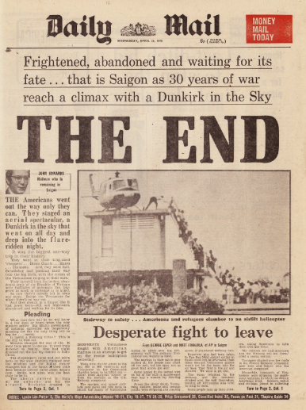
*APRIL 30, 1975 - THE LAST REMAINING U.S. PERSONNEL EVACUATED THE U.S. EMBASSY IN SAIGON FROM THE ROOFTOP
BY HELICOPTER

Slide 27
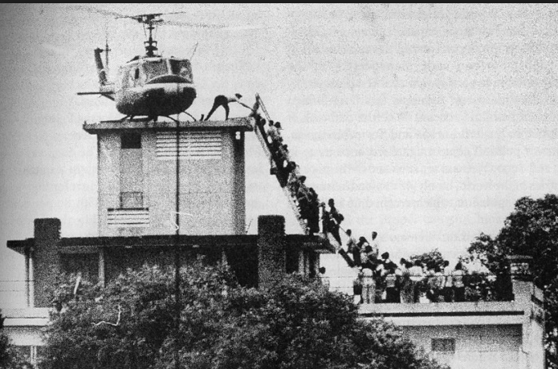
*APRIL 30, 1975 - THE LAST REMAINING U.S. PERSONNEL EVACUATED THE U.S. EMBASSY IN SAIGON FROM THE ROOFTOP
BY HELICOPTER

Slide 28
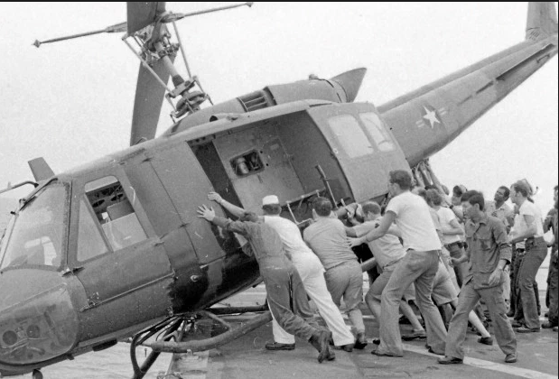
*APRIL 30, 1975 - THE LAST REMAINING U.S. PERSONNEL EVACUATED THE U.S. EMBASSY IN SAIGON FROM THE ROOFTOP
BY HELICOPTER

Slide 29
Reunification of Vietnam in 1975
NV invasion violated the terms of
the 1973 Peace Treaty
Socialist Republic of Vietnam
A sick feeling for most Americans
8 years + of war and Turmoil at home
American Soldiers, Nurses, Journalists Died
Physical and Psychological Injuries
South Vietnam falls to Communism
The last Americans leaving had to leave behind S. Vietnamese allies/friends -- ???

Slide 30
For American Families Still Waiting
Fall of Saigon had Another Meaning
By 1975 the total number of American remains
returned to the US or identified was up to 63
Work with Vietnam on retrieving American Soldiers remains
comes to a halt after the fall of Saigon in 1975

Slide 31
In the mid-1980’s relations between USA and Vietnam improved and cooperation resumed
between USA, Vietnam, Laos
for continuing work to resolve all last known MIA’s, POW’s, LKA’s

Slide 32
1980’s – Remains of 24 Americans
brought home for burial
1999 - Remains of 36 Americans brought home
2000 - 24 more
2001 - 23 more
The division of the military tasked with these forensic investigations is nicknamed the
Bone Collectors
Their Work Continues

Slide 34
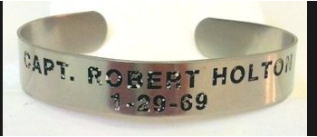
July 12, 2017
Remains of Vietnam Veteran Returns Home
After 48 Years
Capt. Robert Edwin Holton is Coming Home
His plane was shot down over Laos during the Vietnam War

